Slide 1


Final Project Presentation
Shilpa Singh, Dhivya Swaminathan, Yuhan Zeng
Z534 Search
April 24, 2019

Slide 2
Task 1: Categories Classification
Task: predict categories via “Review” and “Tip” text
e.g.
“business_id”: “tnhfDv5Il8EaGSXZGiuQGg”
"categories": “Mexican, Burgers, Restaurants”
“Review”: “Great place to hang out after work: the prices are decent, and the ambience is fun. It's a bit loud, but very lively. The staff is friendly, and the food is good. They have a good selection of drinks”
“Tip”: “Secret menu - fried chicken sando is da bombbbbbb Their zapatos are good too.”

Slide 3
Multi-Class vs. Multi-Label Classification
multi-label classification is a variant of the classification problem where multiple labels may be assigned to each instance.
multi-class classification (single label)
multi-label classification
+
Restaurants
Restaurants
Bars
Businesses
Businesses
+
+
Salon
Cinemas
Cinemas
Spas
Shopping
Shopping

Slide 4
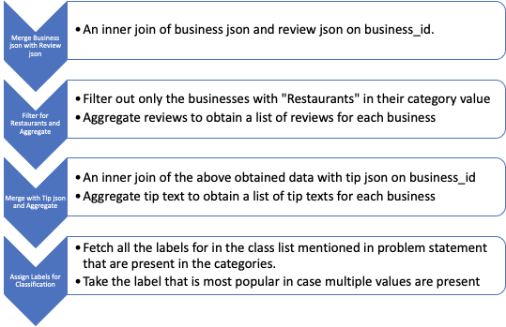
Approach 1: Multi-Class Classification
Problem Statement: To Classify restaurants into one of the following cuisines: Indian, Mexican, Chinese, Italian, Asian Fusion, American, Japanese, Thai, Seafood, Mediterranean, French.

Slide 5
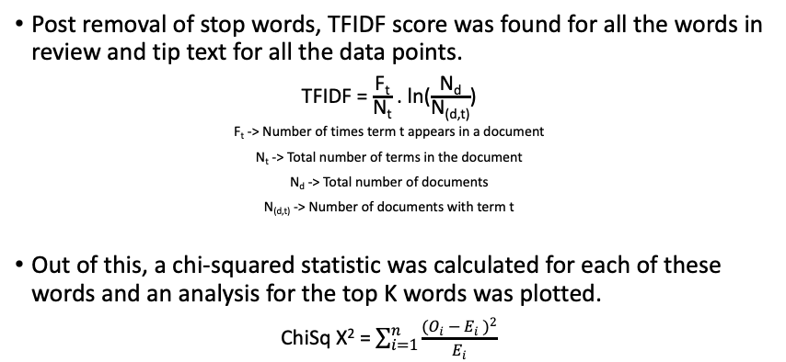
Methodology

Slide 6
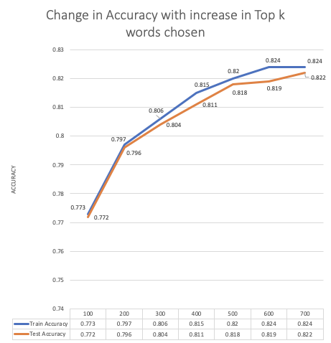
Choosing the best K
With increase in the K (number of top words chosen), the accuracies improved.
This is reasonable as more the words, we get more information about the type of cuisine the restaurant provides.
To tradeoff between model complexity and model performance, k was chosen to be 500 and Top 500 words from reviews and tips were taken.
The results presented here are for a Naïve Bayes model.
Finally, an accuracy of 81.8% was achieved on the test set.

Slide 7
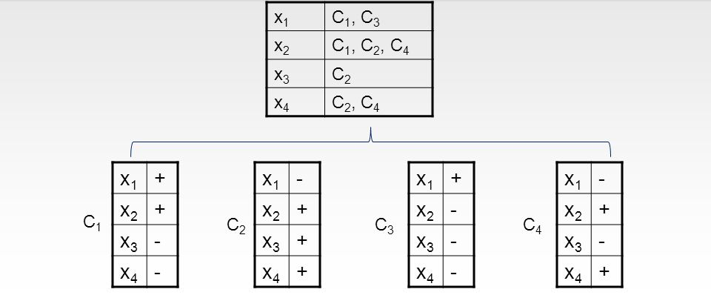
Approach 2: Multi-Label Classification
Problem statement: Given a restaurant, assign it a set of applicable categories
Decompose multi-label into multiple independent binary classification problems (one classifier per label)
One-vs-rest Classifier (one-vs-all)
Train
classifier1
classifier2
classifier3
classifier4
Any binary classifier
Predict
C1
C2
C3
C4

Slide 8
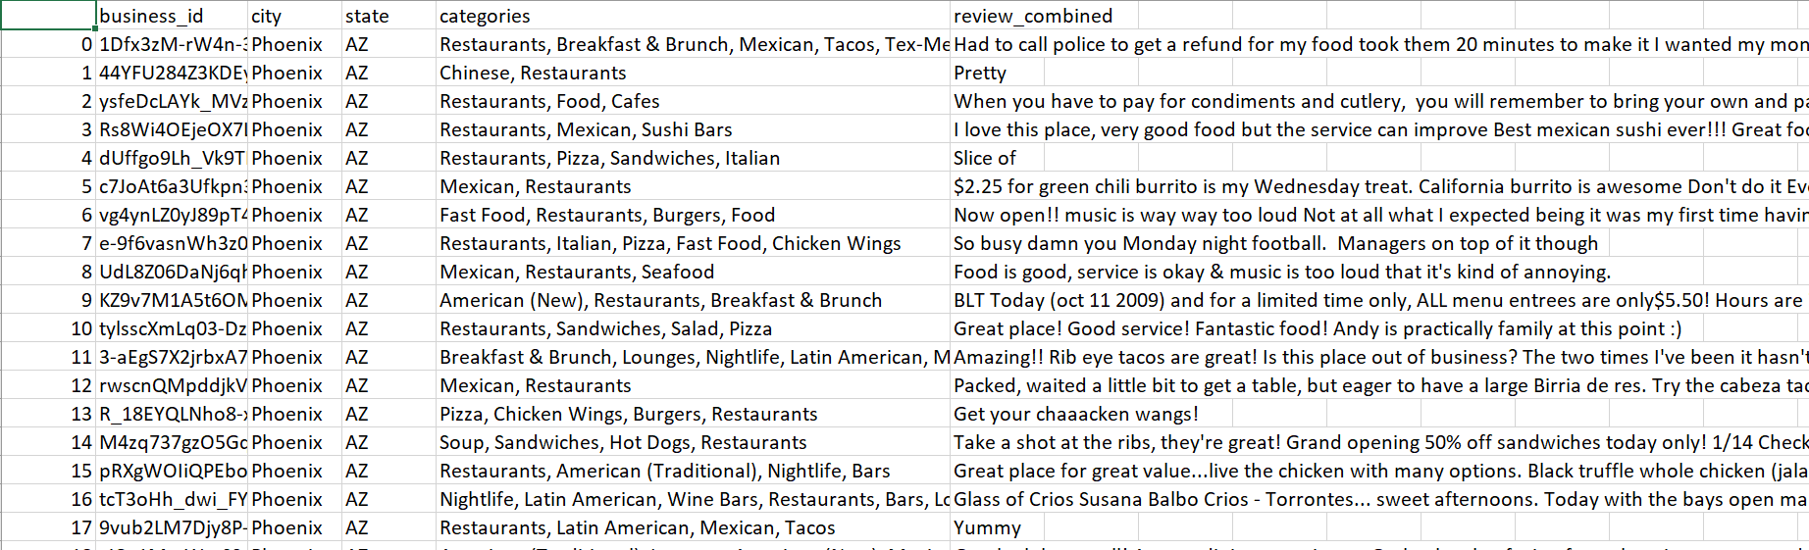
Dataset Filtering
Yelp dataset: 192,600+ businesses, 11,000+ categories
Narrow down: all Restaurants located in Phoenix, AZ
4000+ restaurants, 500+ categories!

Slide 9
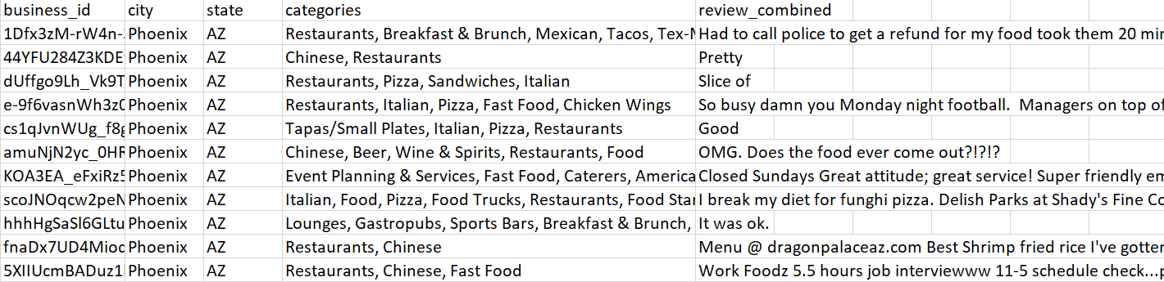
Dataset Filtering
Only restaurants containing “Chinese” or “Fast Food” or “Italian” or “Pizza” or “Sandwiches” 🡪 779 restaurants, 201 categories

Slide 10
Data preprocessing
Combine all reviews or tips for each restaurant into one text field
Lowercase, tokenization, removing common English stop words
CountVectorizer to convert tip/review text into a count matrix
MultiLabelBinarizer to convert multiple labels into binary matrix
Business | Labels
Restaurant 1 | [“Mexican”, “Fast Food”]
Restaurant 2 | [“Italian”, “Pizza”, “Fast Food”]
Restaurant 3 | [“Indian”]
 | Mexican | Fast Food | Italian | Pizza | Indian
Restaurant 1 | 1 | 1 | 0 | 0 | 0
Restaurant 2 | 0 | 1 | 1 | 1 | 0
Restaurant 3 | 0 | 0 | 0 | 0 | 1

Slide 11
Results
Data: 779 restaurants, 201 categories. Train-test-split: 7: 3
 | Text: Tips Classifier: One-vs-rest + Multinomial Naïve Bayes | Text: Reviews Classifier: One-vs-rest + Multinomial Naïve Bayes
Accuracy | 27.6% | 35.7%
Precision | 32.2% | 53.8%

Slide 12
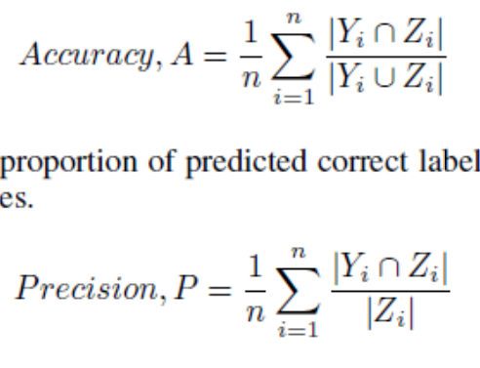
Evaluation Metrics
(Actual) | Active Life | American (New) | African | … | Indian | Italian | … | Thai
Restaurant 1 | 1 | 0 | 0 | … | 0 | 1 | … | 0
Restaurant 2 | 0 | 1 | 1 | … | 0 | 0 | … | 0
(Prediction) | Active Life | American (New) | African | … | Indian | Italian | … | Thai
Restaurant 1 | 1 | 0 | 0 | … | 0 | 1 | … | 0
Restaurant 2 | 0 | 1 | 0 | … | 0 | 0 | … | 0
Y_{i}: predicted label vector for each instance i, Z_{i}: actual label vector

Slide 13
Further Filtering
Given only five labels: “Chinese” or “Fast Food” or “Italian” or “Pizza” or “Sandwiches”→5 categories, 779 restaurants
Text: Tips | SVC | Multinomial Naïve Bayes | Random Forest
Accuracy | 8.6% | 63.4% | 48.1%
Precision | 9.0% | 70.2% | 49.8%
Text: Reviews | SVC | Multinomial Naïve Bayes | Random Forest
Accuracy | 58.0% | 78.0% | 67.4%
Precision | 59.0% | 89.9% | 68.8%

Slide 14
Task 2: Rating prediction from Review Text
Motivation: User ratings are not objective all the time.Its is possible that a very positive review has a 5-star rating but a similar one has a 3-star rating.Rating standards of people are different.This may adversely affect the restaurants business.So,to solve this problem,we have tried to predict rating from the review text.
Dataset used: All Reviews for which the Business fall under “Restaurant “ category.
1347779 Reviews for 59371 Business

Slide 15
Technical Approach and Models:
We have used different models to predict the rating stars.All of these have common underlying theme which is extracting features of a review to help predict the sentiment.The difference in these models is the type of features are that used.These are Tf-Idf,Sentiment score,Probability distribution of Topic(LDA) and Probability distribution of Topic and Sentiment Score combined(LDA + sentiment)
Reviews Dataset
TF-IDF
LDA
Sentiment
LDA +
Sentiment
Feature Generation
Train Dataset(80%)
Test Dataset(20%)
Train models
Test models
SparkLinear
Regression
Spark Gradient Boost Regression
SparkLinear
Regression
Spark Gradient
Boost Regression

Slide 16
Computing Platform and Implementation Libraries:
Storage and Computing: We have used HDFS(3-node) cluster to store the json files and Spark as our Distributed Computing Platform.
Implementation Libraries:
Spark Mllib:MLlib is scalable machine learning library implemented to run the algorithms on several data partitions on different nodes.We have used the following Spark implementations:
LDA : Expectation Maximization approach where the parameter learning uses constant number
of iterations.
Spark Feature Transformation API: CountVectorizer and IDFModel for Tf-Id,VectorAssembler
for combining different features and SparkLinearRegression and GradientBoostRegression for
RMSE and MAE comparisons.
NLP Library: We have used Spark coreNLP and Stanford coreNLP libraries for text preprocessing .

Slide 17
Implementation Overview:
Text Preprocessing Feature Extraction for Prediction
Reading review and business data
from HDFS using SparkContext
nouns
adjectives
nouns + adjectives
CountVectorization
Sentiment Score Evaluation
Joining and Filtering for business categories “Restaurants”
IDF Model
LDA Topic Modelling
Review text Tokenization
and removing StopWords
Feature
Assembler
Pos Tagging and filtering
TF-IDF score
Topic Distribution
Topic Distribution + Sentiment score
Sentiment Score
nouns
adjectives
nouns +
adjectives
TF-IDF
LDA
LDA + Sentiment
Sentiment

Slide 18
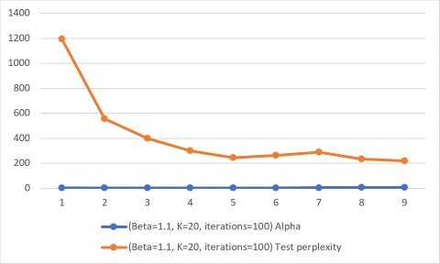
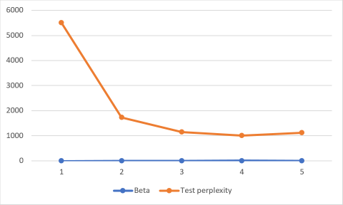
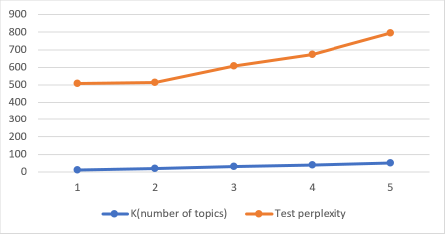
LDA Parameter Estimation:
Optimal values : Alpha =[3.0,3.5].Beta=1.1,k=20
Beta:Distribution over terms =1.1,k=20,Iterations =100
Varying Alpha keeping other parameters constant
Alpha:Distribution over topics =1.1,k=20,
Iterations =100
Varying Beta keeping other parameters constant
Alpha= 3,Beta =1.1,Iterations = 100
Varying number of topics keeping other parameters constant

Slide 19
Regression for Rating prediction
TF-IDF
nouns,adjectives,
nouns+adjectives
LDA
nouns,adjectives,
nouns+adjectives
LDA Sentiment
nouns,adjectives
nouns+adjectives
Sentiment
nouns.adjectives,nouns+adjectives
Spark Linear Regression
Spark Gradient Boost Regression
Rating Prediction and MAE and RMSE Comparison

Slide 20
Regression Results
SparkLinearRegression:
 | nouns |  | adjectives |  | nouns + adjectives
 | MAE | RMSE | MAE | RMSE | MAE | RMSE
LDA | 1.085 | 1.303 | 1.139 | 1.357 | 0.980 | 1.187
TF-IDF | 1.145 | 1.363 | 1.122 | 1.336 | 1.119 | 1.332
LDA + Sentiment | 0.862 | 1.021 | 0.944 | 1.116 | 1.032 | 1.210
Sentiment | 1.152 | 1.371 | 1.084 | 1.299 | 1.121 | 1.340

Slide 21


